Slide 1


KGiSL INSTITUTE OF TECHNOLOGY
COIMBATORE
DEPARTMENT OF computer science & engineering
FINAL Project review
IOT - BASED SMART STREET LIGHT SYSTEM
USING ESP32
711722104022 DEEPAN A
711722104023 DEEPIKA G
711722104030 DINESHKUMAR M
711722104050 JEEVIKA M P
Under the guidance of :
Ms. GEETHA V , Assistant Professor CSE.

Slide 2
PROBLEM STATEMENT
Street lighting is widely used for ensuring safety and visibility in both urban and rural areas during nighttime.
Most traditional systems rely on manual control or fixed timing, which often leads to lights staying ON even during the daytime, causing energy wastage.
These systems mainly focus on providing lighting but ignore automation and real-time monitoring, making them less efficient.
They are also vulnerable to issues like fault detection delay, as problems are identified only through manual inspection.
Studies show that inefficient street lighting systems lead to increased electricity costs and reduced overall system performance.
To address these issues, the proposed system introduces an IoT-based smart street lighting solution using ESP32, which enables automatic control, fault detection, and real-time monitoring for better efficiency and reliability.

Slide 3
OBJECTIVE OF THE PROJECT
To develop an IoT-based smart street lighting system that automatically controls lights using sensor data.
To use the ESP32 microcontroller for processing data, controlling sensors, and enabling wireless communication.
To implement an LDR sensor for automatic day–night detection, ensuring lights turn ON at night and OFF during the day.
To use solar energy with battery storage for a sustainable and energy-efficient power supply.
To detect street light faults using a current sensor and enable real-time monitoring through the ThingSpeak cloud platform.
To improve energy efficiency, reduce electricity costs, and support smart and sustainable city infrastructure.

Slide 4
LITERATURE REVIEW
S.no | Title of the Paper | Problem Statement | Given / Proposed Solution | Limitations
1 | IoT-Enabled Solar-Based Smart Street Lighting System (2025) | Lights remain ON unnecessarily, causing energy waste. | LDR and IR sensors used for automatic ON/OFF and motion detection. | Sensor performance may vary with environment.
2 | Smart Street Light System with LDR and IR Sensors (2025) | High energy consumption due to static lighting systems. | Traffic-based adaptive lighting to adjust brightness based on vehicle movement. | Requires complex sensors and high implementation cost.
3 | IoT Enabled Intelligent Street Lighting System (2024) | Lack of smart control in traditional street lighting. | IoT-based intelligent system for automated lighting. | Requires strong network and higher cost.

Slide 5
S.No | Title of the Paper | Problem Statement | Given / Proposed Solution | Limitations
4 | Enhanced Streetlight Management Using IoT and ESP32 (2024) | Delay in detecting faults manually. | ESP32-based IoT system for automatic fault detection. | Network dependency and scalability issues.
5 | Centralized Monitoring System for Fault Detection (2024) | Difficulty in identifying and locating faults. | Centralized monitoring with location tracking. | High infrastructure cost.
6 | IoT-Based Smart Street Light System (2023) | High power consumption and lack of automation. | IoT system for automatic control and energy saving. | Limited real-time fault detection.
7 | Smart Street Light with Automatic Brightness Adjustment (2021) | Fixed brightness wastes energy. | Automatic brightness control using IoT platform. | Needs continuous internet access.

Slide 6
S.no | Title of the Paper | Problem Statement | Given / Proposed Solution | Limitations
8 | IoT Based Automatic Monitoring and Control System (2020) | Lack of proper monitoring and control. | IoT-based remote monitoring and automation. | Depends on IoT infrastructure.
9 | IoT Based Smart Street Light Management System (2017) | Manual operation and inefficient management. | IoT-based system for better control and efficiency. | No advanced fault detection.
10 | Energy-Efficient Intelligent Street Lighting System (2016) | High energy consumption in static systems. | Traffic-based adaptive lighting system. | Complex and costly implementation.
11 | Energy Efficiency of Lighting Installations (2015) | Inefficient energy usage in lighting systems. | Software-based analysis to improve efficiency. | No real-time implementation.

Slide 7
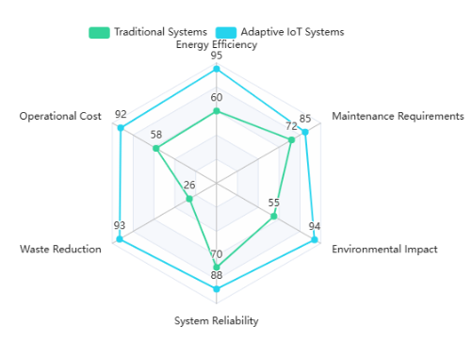
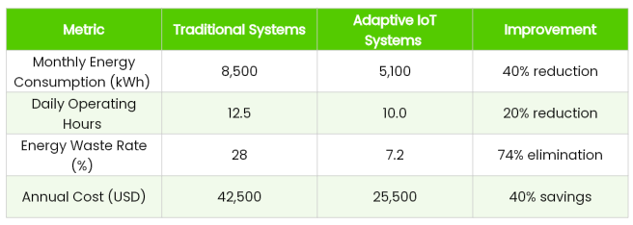
EXISTING SYSTEM
DRAWBACKS
Most existing street lighting systems still depend on manual control or basic automation, which leads to inefficient operation and energy wastage.
Many research works focus on automation using sensors, but they lack advanced real-time monitoring and centralized control features.
Fault detection in existing systems is either limited or delayed, making maintenance slow and less effective.
High installation cost, scalability challenges, and environmental factors (like weather affecting sensors or solar systems) reduce the overall efficiency and practicality of existing solutions.

Slide 8
PROPOSED SYSTEM
The proposed system uses automatic control with sensors, eliminating the need for manual operation and reducing unnecessary energy usage.
It intelligently turns street lights ON/OFF based on real-time light conditions, ensuring efficient power utilization.
A current sensor is used to continuously monitor the system, enabling quick and accurate fault detection without delay.
The system is integrated with IoT and cloud platforms, allowing real-time monitoring and remote access from anywhere.
It reduces maintenance time and effort by instantly identifying faults, improving overall system reliability.
Compared to existing systems, this solution is more efficient, cost-effective, and scalable, providing better energy management and smarter street lighting control.

Slide 9
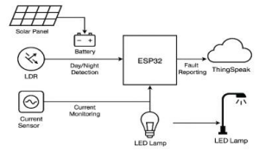
SYSTEM ARCHITECTURE
The system uses a solar panel to supply power, making it energy-efficient and suitable for outdoor use.
Sensors like LDR and current sensor collect real-time data and send it to the ESP32 for processing.
The ESP32 controls the street light based on light conditions and detects any faults in operation.
All data, including light status and faults, is sent to ThingSpeak via Wi-Fi for remote monitoring.

Slide 10
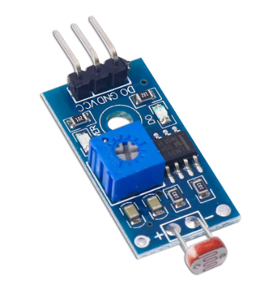
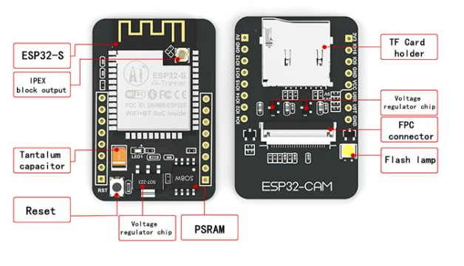
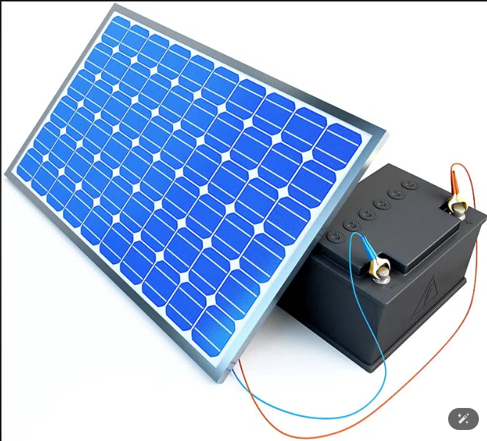
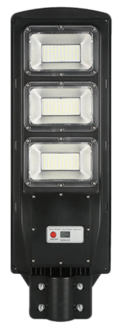
HARDWARE COMPONENTS
ESP32 microcontroller is used as the main unit to control the system and process data.
LDR sensor is used to detect light levels and identify day and night conditions.
Current sensor is used to monitor current flow and detect faults in street lights.
Solar panel with battery is used to provide renewable energy and continuous power supply.
LED street light and basic components like resistors and wires are used for lighting and circuit connections.

Slide 11
SOFTWARE COMPONENT
Arduino IDE and Embedded C are used to write and upload the program, which controls sensors and system operations.
ESP32 libraries help in connecting sensors and managing hardware functions smoothly.
Wi-Fi communication enables data transfer from the ESP32 to the cloud for remote monitoring.
ThingSpeak platform is used to store and analyze real-time system data.

Slide 12
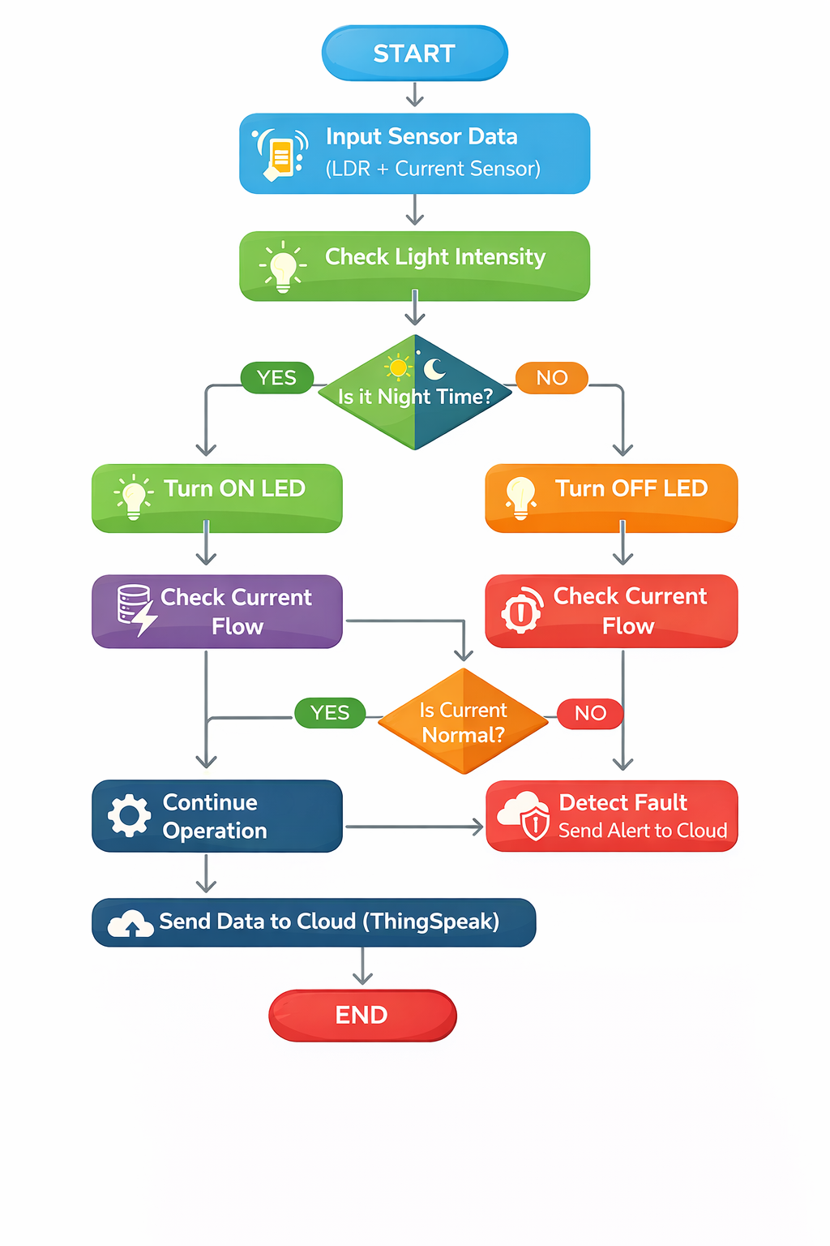
IMPLEMENTATION DETAILS
The proposed system uses different modules to handle automatic lighting and monitoring.
Light Detection Module (LDR Sensor)
Detects ambient light intensity to determine day and night conditions.
Power Supply & Solar Energy Module
Provides renewable power using solar panels and battery storage.
Street Light Control Module
Automatically turns lights ON at night and OFF during daytime.
Fault Detection & IoT Monitoring Module (Current Sensor + ThingSpeak Cloud)
The system automatically switches the lights ON during nighttime and turns them OFF during daytime based on surrounding light conditions.

Slide 13
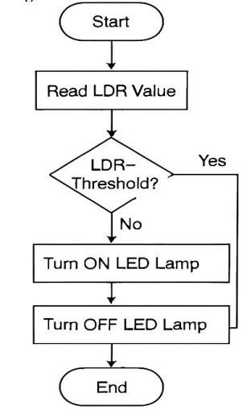
METHODOLOGY
MODULE – 1 LIGHT DETECTION RESISTOR
The system automatically starts and uses an LDR sensor to continuously monitor the surrounding light conditions.
It checks the light intensity and compares it with a set threshold to understand whether it is day or night.
During daytime (high light), the street lights remain OFF, and at night (low light), the lights turn ON automatically.
This process happens continuously in real time, without any need for manual control.
As a result, it saves energy, reduces human effort, and improves the overall efficiency and reliability of the system.

Slide 14
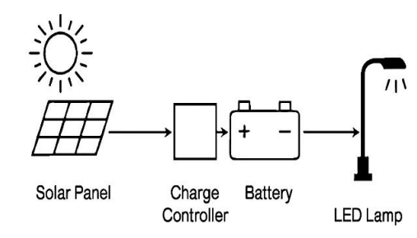
MODULE - 2 SOLAR STREET LIGHT SYSTEM
The solar panel collects sunlight during the day and converts it into electrical energy.
The generated energy is safely controlled and stored in a battery for later use.
During nighttime, the stored energy is used to power the street light.
This ensures continuous lighting even without sunlight.
The system works independently and supports sustainable energy usage.

Slide 15
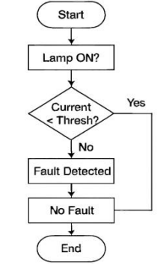
MODULE - 3 FAULT DETECTION
The system starts by checking whether the street light is turned ON and working.
A current sensor continuously monitors the flow of electricity in real time.
The measured current is compared with a set threshold to check if everything is normal.
If the current is low, it indicates a possible fault like lamp failure or wiring issues; if normal, the system confirms proper functioning.
This helps in quickly detecting faults, reducing manual inspection, and improving maintenance and overall system reliability.

Slide 16
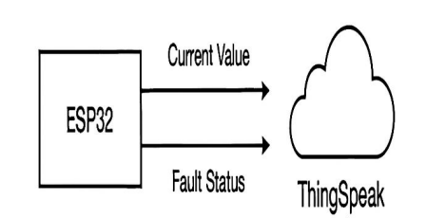
MODULE - 4 DATA TRANSMISSION USING ESP32 AND THINGSPEAK
The system begins by connecting the ESP32 to Wi-Fi and starts collecting data from the current sensor.
It continuously monitors the current and checks for any faults based on predefined conditions.
The current values and fault status are then prepared and sent to the cloud platform (ThingSpeak).
The data is stored and displayed as graphs, allowing users to easily track system performance.
This real-time monitoring helps in quick fault detection, remote access, and better system control and analysis.

Slide 17
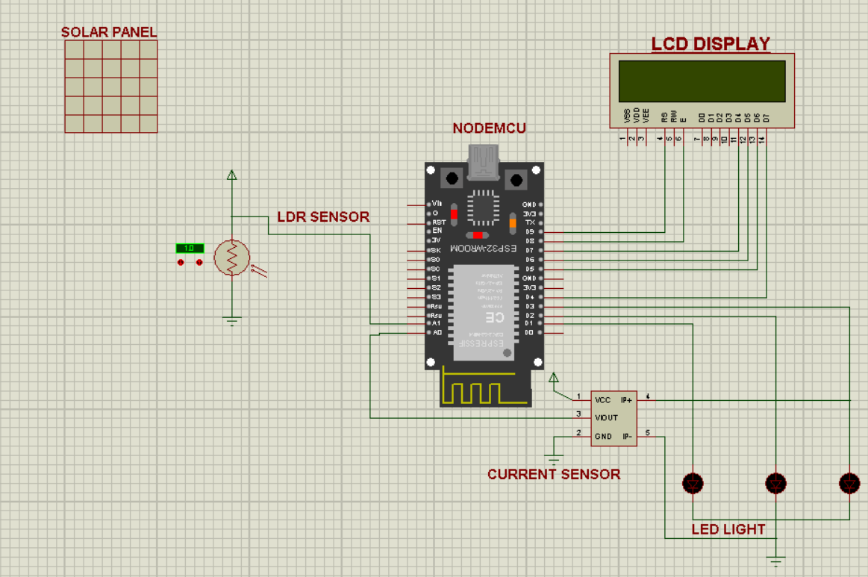
CIRCUIT DIAGRAM

Slide 18
TECHNOLOGY USED
ESP32 Microcontroller is used as the main controller to process sensor data, control system operations, and enable wireless communication through built-in Wi-Fi.
Arduino IDE is used to write, compile, and upload the program to the ESP32, making development and hardware interfacing easier.
Embedded C Programming is used to implement the system logic, including sensor data processing, decision-making, and automatic control of street lights.
ThingSpeak Cloud Platform is used to store, analyze, and display real-time data through graphs for remote monitoring and system analysis.
Wi-Fi Communication enables the ESP32 to send sensor data to the cloud, allowing users to monitor the system from anywhere.
Sensor Technologies (LDR & Current Sensor) are used to detect light intensity for automatic switching and monitor current flow for fault detection.

Slide 19
SYSTEM CONFIGURATION
Processor: Intel Core i3/i5 processor is recommended to support programming, simulation, and smooth execution of IoT applications.
Memory (RAM): A minimum of 4 GB RAM is required to run Arduino IDE, browser, and cloud platforms without lag.
Storage: At least 100–250 GB storage is needed to store project files, code, and related datasets.
Hardware Components: ESP32, LDR sensor, current sensor, solar panel, battery, LED lights, and basic electronic components are required for system implementation and testing.
Input Devices: A standard keyboard and mouse are used for coding, uploading programs, and interacting with the system.
Operating System and Software: The system works on Windows OS using Arduino IDE for programming and ThingSpeak platform for real-time cloud monitoring and data visualization.

Slide 20
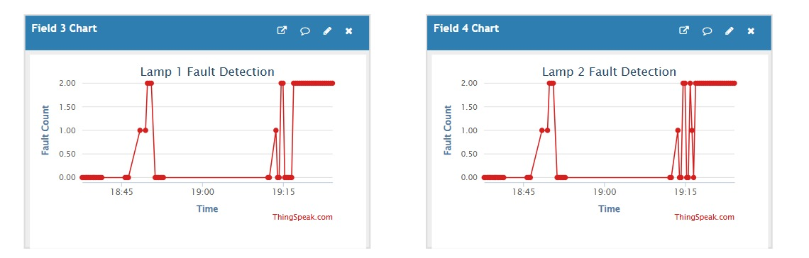
RESULTS AND ANALYSIS – FAULT DETECTION OUTPUT
The solar panel collects sunlight and powers the system, making it energy-efficient and suitable for outdoor use.
The ESP32 acts as the brain, receiving data from sensors and making decisions automatically.
Based on the sensor input, the system controls the LED street light, turning it ON or OFF as needed.
Using Wi-Fi, the ESP32 sends system data to the cloud, allowing easy remote monitoring and control.

Slide 21
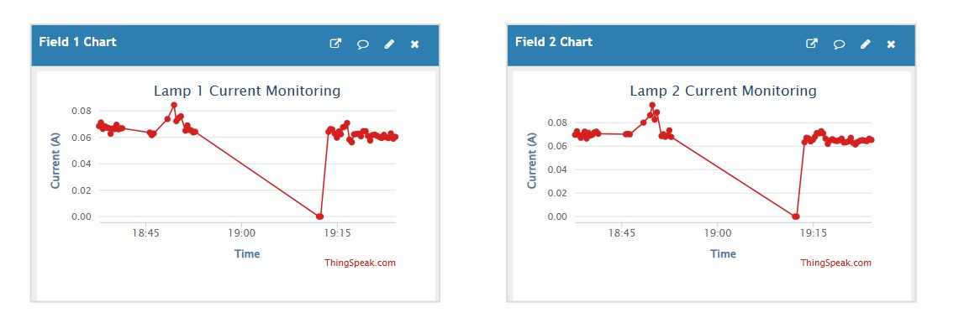
RESULTS AND ANALYSIS – CURRENT MONITORING OUTPUT
The graphs show real-time current values of Lamp 1 and Lamp 2 using cloud monitoring.
When the current is stable, it indicates the street lights are working in normal condition.
A sudden drop to zero current clearly shows a fault condition like disconnection or lamp failure.
After the fault, the current returns to normal, proving the system can detect and monitor faults effectively.

Slide 22
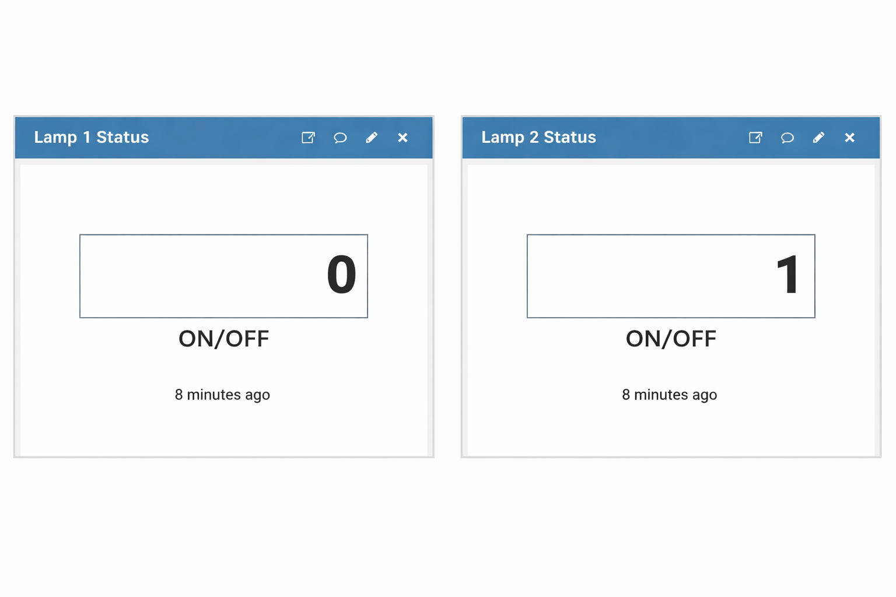
RESULTS AND ANALYSIS – LAMP STATUS OUTPUT
The display shows the status of Lamp 1 and Lamp 2 in real time using simple digital values.
Value 0 indicates OFF condition, meaning the lamp is not glowing.
Value 1 indicates ON condition, showing the lamp is working properly.
This simple representation helps in easy monitoring and quick understanding of lamp status.

Slide 23

Environmental Impact & Sustainability
Solar Energy Benefits
The system uses solar power, reducing dependence on grid electricity and ensuring a continuous power supply.
Carbon Footprint Reduction
It lowers carbon emissions compared to traditional street lights, making it more eco-friendly.
Operational Cost Efficiency
It requires less maintenance and reduces overall operating costs over time.
Green Infrastructure Contribution
It supports sustainable development and helps build smart, environmentally friendly cities.

Slide 24
ADVANTAGES
Automatic Operation Street lights turn ON and OFF automatically, eliminating the need for manual control.
Fault Detection Capability The system can quickly identify faults in street lights using current sensor monitoring.
Renewable Energy Usage Solar panels provide a sustainable power source, reducing dependence on conventional electricity.
Real-Time Monitoring The system allows users to monitor performance and faults remotely through the cloud platform.

Slide 25
APPLICATIONS
Urban & Rural Street Lighting Provides efficient and automated lighting for streets in both urban and rural areas.
Highway & Road Safety Systems Improves visibility at night, helping in safer transportation.
Smart City Infrastructure Supports smart city development with automated monitoring and control.
Public Places & Parking Areas Ensures proper lighting in areas like parks, bus stops, and parking zones.
Residential & Industrial Areas Offers reliable and cost-effective lighting for homes, campuses, and industries.

Slide 26
CONCLUSION AND FUTURE WORKS
Efficient & Automated System The proposed system provides an efficient solution by automatically controlling street lights based on real-time conditions.
Energy Saving & Cost Reduction It reduces energy consumption and electricity costs using solar power and smart sensing.
Improved Reliability & Monitoring The system detects faults early and allows real-time monitoring through the cloud.
Future Enhancements Features like mobile app control and GPS tracking can be added for better monitoring and maintenance.
Advanced Technologies Data analytics and automatic brightness control can further improve system efficiency and support smart city development.

Slide 27
REFRENCES
M. V, R. R, R. M, S. S, S. S and M. K. C, "IoT-Enabled Solar-Based Smart Street Lighting System Using ESP32 and Cloud Platforms," 2025 6th International Conference on Inventive Research in Computing Applications (ICIRCA), Coimbatore, India, 2025, pp. 754-759, doi: 10.1109/ICIRCA65293.2025.11089762.
Sanjana Thakur, Mohammed Baqar Quadri , Mohammed Abu Naser , Abdul Kareem Ghori ,Mohammed Imaduddin , “Smart Street Light System with LDR And IR Sensors for Energy-Efficient Illumination”, Indian Journal of Electronics and Communication Engineering, Volume 02, Issue 01, January-April 2025, PP: 08-12.
S. Bhisikar, P. Jagtap, S. Sonawane, H. Sawant and P. Pisal, "Enhanced Streetlight Management: Using IoT and ESP32 for Automated Fault Detection," 2024 IEEE 5th India Council International Subsections Conference (INDISCON), Chandigarh, India, 2024, pp. 1-6, doi: 10.1109/INDISCON62179.2024.10744375.
M. S et al., "Centralized Monitoring System Street Light Fault Detection and Location Tracking for Smart City," 2024 International Conference on Electronics, Computing, Communication and Control Technology (ICECCC), Bengaluru, India, 2024, pp. 1-7, doi: 10.1109/ICECCC61767.2024.10593930.
A. S. Karimeh, K. -Y. Chan, C. -L. Lee, G. -C. Chung, W. -L. Pang and S. M. Mitani, "IoT Enabled Intelligent Street Lighting System for Smart Cities," 2024 Multimedia University Engineering Conference (MECON), Cyberjaya, Malaysia, 2024, pp. 1-7, doi: 10.1109/MECON62796.2024.10776428.

Slide 28
Chaudhary, P., Singh, V., Karjee, A., Singal, G., Tomar, A. (2023). Design of Energy Efficient IoT-Based Smart Street Light System. In: Woungang, I., Dhurandher, S.K., Pattanaik, K.K., Verma, A., Verma, P. (eds) Advanced Network Technologies and Intelligent Computing. ANTIC 2022. Communications in Computer and Information Science, vol 1797. Springer, Cham. https://doi.org/10.1007/978-3-031-28180-8_17
S. M. Sorif, D. Saha and P. Dutta, "Smart Street Light Management System with Automatic Brightness Adjustment Using Bolt IoT Platform," 2021 IEEE International IOT, Electronics and Mechatronics(IEMTRONICS), 2021, pp1-6,doi: 10.1109/IEMTRONICS52119.2021.9422668
S. Kadirova, T. Nenov and D. Kajtsanov, "IoT Based Automatic Electronic System for Monitoring and Control of Street Lighting," 2020 IEEE 26th International Symposium for Design and Technology in Electronic Packaging (SIITME), 2020, pp. 122-126, doi: 10.1109/SIITME50350.2020.9292246
P. P. F. Dheena, G. S. Raj, G. Dutt and S. V. Jinny, "IOT based smart street light management system," 2017 IEEE International Conference on Circuits and Systems (ICCS), 2017, pp. 368-371, doi: 10.1109/ICCS1.2017.8326023
J. A. Lobão, T. Devezas, and J. P. S. Catalão, “Energy efficiency of lighting installations: Software application and experimental validation,” Energy Reports, vol. 1, pp. 110–115, 2015, doi: 10.1016/j.egyr.2015.04.001.
Shahzad, G., Yang, H., Ahmad, A.W., Lee, C. Energy-Efficient Intelligent Street Lighting System Using Traffic-Adaptive Control // IEEE Sensors Journal, 2016, Vol. 16, # 13, pp. 5397–5405.

Slide 29
THANK YOU

